Slide 1
Project Management:
Process, Technology, and Practice
Ganesh Vaidyanathan
Updated by: Osama Hosameldeen
Chapter 1
Projects and Project management

Slide 2

Projects and Project Management
Proposed in Project Charter
Specified in Project Scope
Designed
Programmed
Installed at user site
What the user wanted!

Slide 3

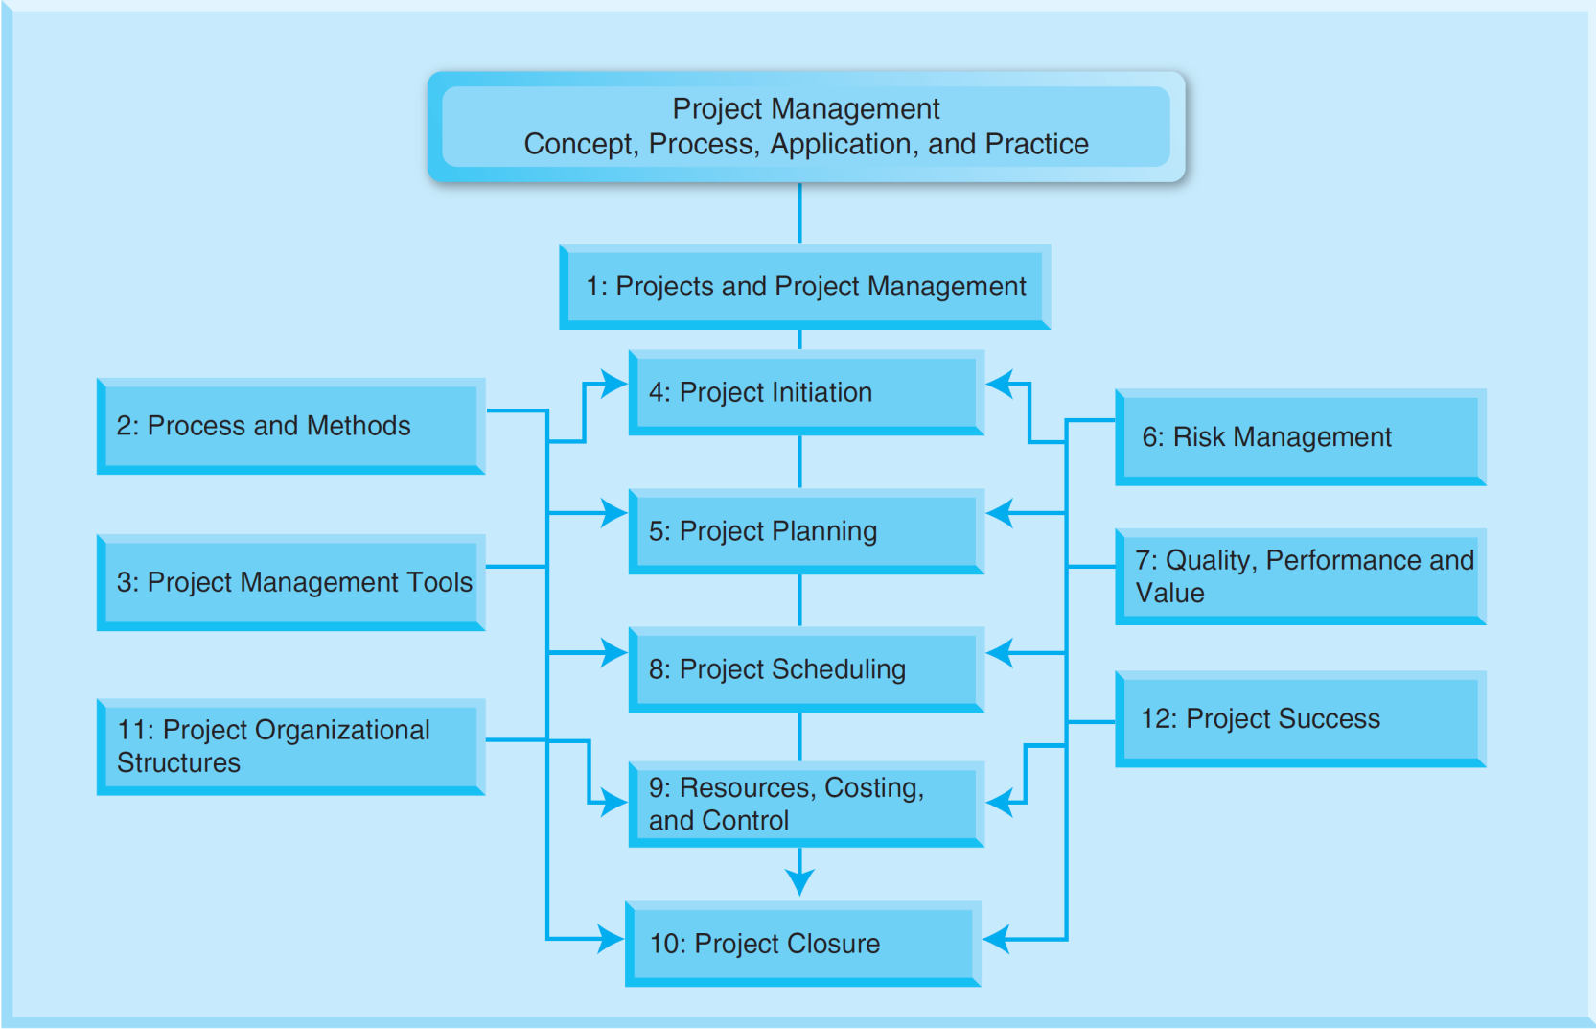
Projects and Project Management
Overview of Book

Slide 4
Learning objectives
Understand what a project is, provide examples of projects, and understand different types of projects pertaining to various industries.
Classify projects based on technology uncertainty and system scope.
Identify project life span in various industries and explain the basic six phases of a project.
Describe project management and its benefits.

Slide 5
Learning objectives
Identify factors for project success and project management success and understand how these factors affect either the success or failure of projects as well how each one of these factors impact the other five factors in project success.
Identify project management components and understand how these components can be used to realize project success.

Slide 6
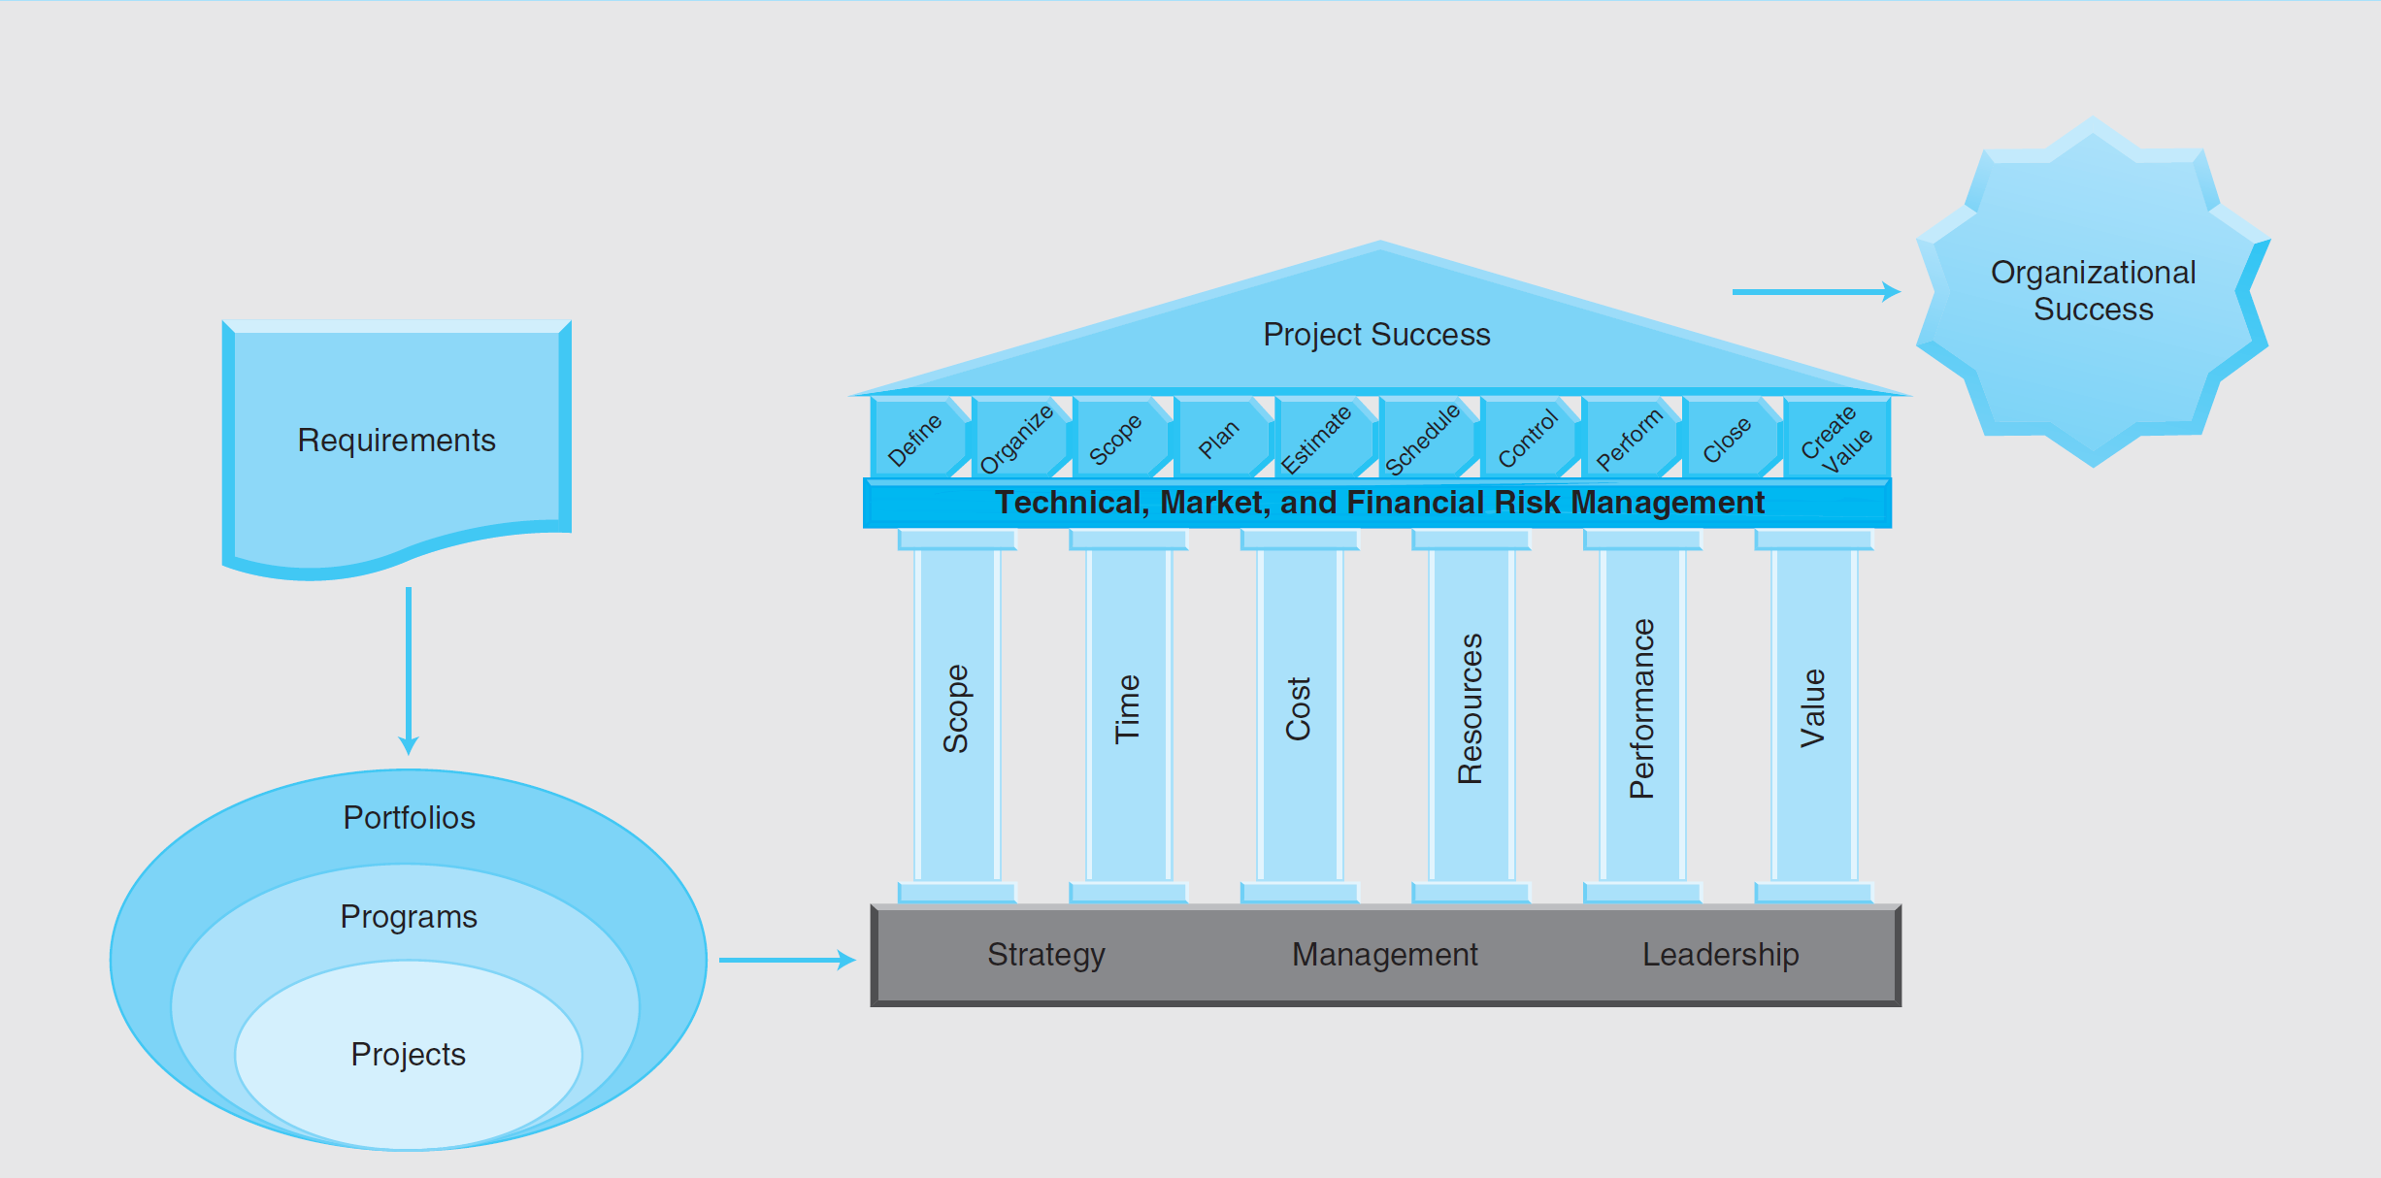

Slide 7
Projects
A project:
Is a unique activity.
Has a beginning.
Has an end – a definite end.
Has constraints and requirements.
Scope, Cost, Schedule, Resources, Performance, Value
Has to add value.
Chores for the day…
Clean room
Do Homework
Make a sandwich -
everything is in the fridge
4. Complete Journal entry
Chore
Project

Slide 8
Types of Projects
Computer related hardware and software projects
Healthcare: Stakeholders may include
Doctors, Pharmaceutical and Insurance companies.
Payers: Individuals, businesses, government organizations.
Fiscal intermediaries: MOs, and Pharmacy.
Hospitals, delivery networks, and individual clinics.
Groups who aggregate healthcare products and services
New Product Development
Construction

Slide 9
Classification of Projects
Three underlying dimensions that encompass almost all aspects of technology are complexity, interdependence, and uncertainty.
Complexity refers to the number of products or operations that are performed at the same time and the resulting degree of difficulty.
Interdependence refers to the extent to which the items or elements upon which work is performed or the work processes themselves are interrelated.
Uncertainty refers to the variability in the process of transformation of inputs to outputs or in the inputs themselves.

Slide 10
Classification of Projects
Dimension of Projects Based on Technology Uncertainty
Project Type | A | B | C | D
Classification | Mature | Improvement | Integration | New Development
Description | Using existing and well tested technologies | Adapting existing well tested technologies with slight improvements | Integrating existing mature technologies | New technologies
Examples | New website | A new website with database integration and new features | SAP implementation, New hardware, Military systems | Space projects

Slide 11
Classification of Projects
Dimension of Projects Based on Complexity
Complexity Level | 1 | 2 | 3
Classification | Low | Medium | High
Description | Assembling components and modules in order to perform a single function | Develop subsystems in order to perform a wide range of functions or activities | Build large systems that function as a single entity in order to achieve a common purpose
Examples | DVDs, CDs, Refrigerators | Computers, iPads, Smart phones, radar, aircraft, ships | Cloud services, a city, public transportation system

Slide 12
Project Life Span
Project life span is a progression through a series of differing stages of development of a project. It is the total phases through which a project passes from the time it is initially conceived until the time it is either in use as a success or abandoned as a failure.
Phase 1 – Conceptualization or Pre-Feasibility
Phase 2 – Planning or Feasibility or Demonstration
Phase 3 – Design/Development
Phase 4 – Implementation/Execution/Testing
Phase 5 – Launch or Termination or Closure
Phase 6 – Post Implementation Review

Slide 13
Project Life Span
Phase 1: Conceptualization or Pre-Feasibility
Conceptualization: A conceptualization is an idea or thought that refers to the reflection of a targeted business function or process and how the various facets of the process or function relate to each other.
A thought process is a series of ideas, thoughts, or decisions.
How and when does this conceptualization process originate?
Pre-feasibility study: A pre-feasibility study is a preliminary study to assess whether to conduct a full feasibility study or not.

Slide 14
Project Life Span
Phase 2: Planning or Feasibility or Demonstration
Before the start of any major project, a complete, realistic, and accurate project plan is very important.
Project planning is the process of setting goals, developing strategies to support an organization’s strategic goals, and outlining tasks and schedules to accomplish project goals.
Planning a project assumes that the project under consideration has been approved for implementation.
The approval can result from Phase 1 conceptualization or pre-feasibility findings.
A feasibility study is a detailed study in a controlled process to identify potential problems and opportunities.

Slide 15
Project Life Span
Phase 3: Design/Development or Development or Engineering/Manufacturing Development
Once Phase 2 is completed, Phase 3 is initiated, and takes a project from planning through construction or realization of project scope.
Design and development follows customer requirements and assesses for quality against predefined criteria.
While analysis is discovering what the requirements are, design is evaluating a number of choices and choosing the best solution.

Slide 16
Project Life Span
Phase 4: Implementation or Execution and Testing or Production and Deployment
This is the phase where products, services, and systems are realized. After the design of a product and its components, the method of manufacturing or production is defined in this phase.
This phase usually consists of both implementation and testing of the implemented product or system.
Drawings, specifications, and contract documents that were prepared in the design phase will be implemented, software will be coded, contracts will be tendered and awarded, and construction work will be undertaken.

Slide 17
Project Life Span
Project closure: Business stakeholders agree to release the product and launch the product for the user or consumer.
Phase 5: Launch or Termination or Closure
A project is brought to its proper completion in this phase.
This is where the business stakeholders agree to release the product and launch the product for the user or consumer.
The client’s formal acceptance is essential in this phase.
Often, lessons learned from previous project completions and installations are used in this phase.
Launch of a product or system usually combines contributions from multiple disciplines in an organization.

Slide 18
Project Life Span
Phase 6: Post-Implementation Review
Progress and success are measured, project documents are archived, lessons learned are captured, and project activities are formally closed.
The post-implementation phase allows an organization to step back and review processes and results.
The organization will consider processes that need adjustment, highlight the most effective processes, and provide action items to improve future projects.
Post-occupancy evaluations are also used to assess the effectiveness of construction or production or implementation.

Slide 19
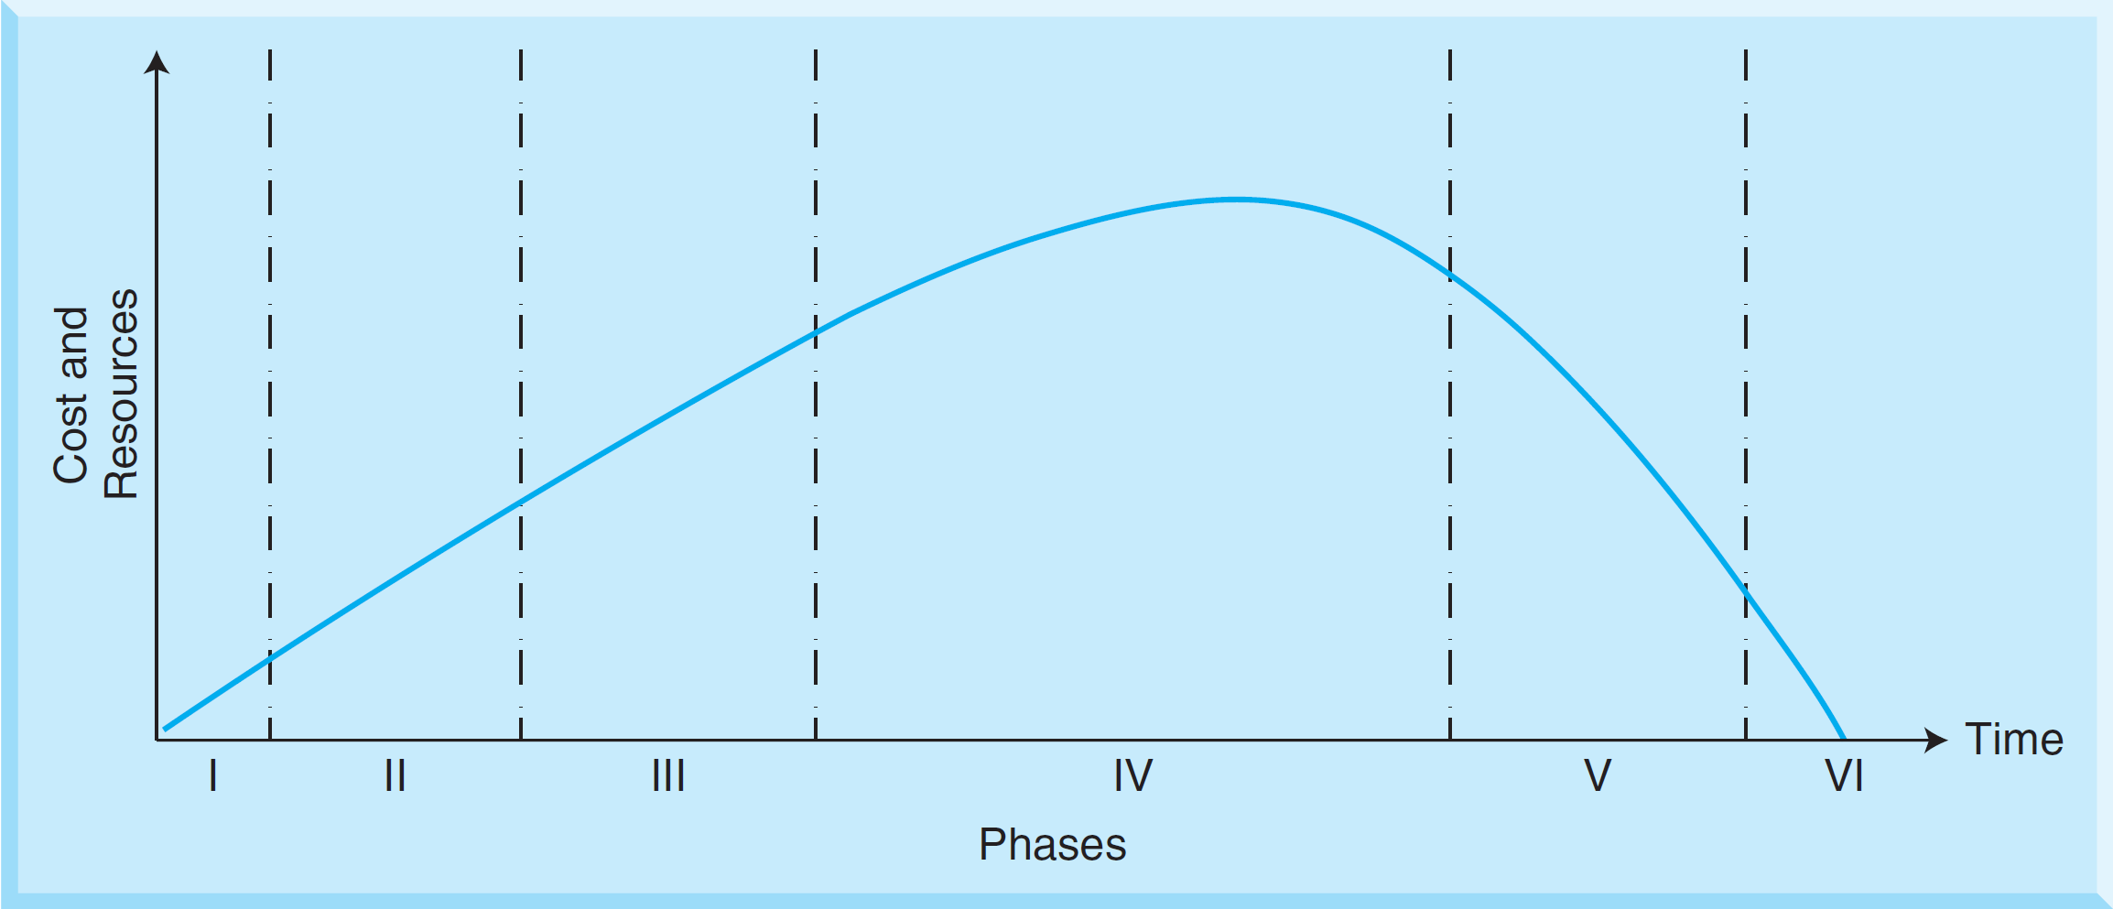
Project Life Span

Slide 20
Project Management Failure Factors
Inadequate rationale, objectives, tasks, and goals
Wrong project manager
Unsupportive top management
Lack or misuse of project management techniques
Inadequate project planning
Lack of commitment to the project

Slide 21
Project Management Failure Factors
Factors and constraints affect either the success or the failure of projects:
Completion of project within scope or customer requirements
Completion of project within allocated budget
Completion of project within allocated schedule or period of time
Completion of project using allocated resources
Completion of project within established performance and technology standards
Completion of project to maximize project value for stakeholders

Slide 22
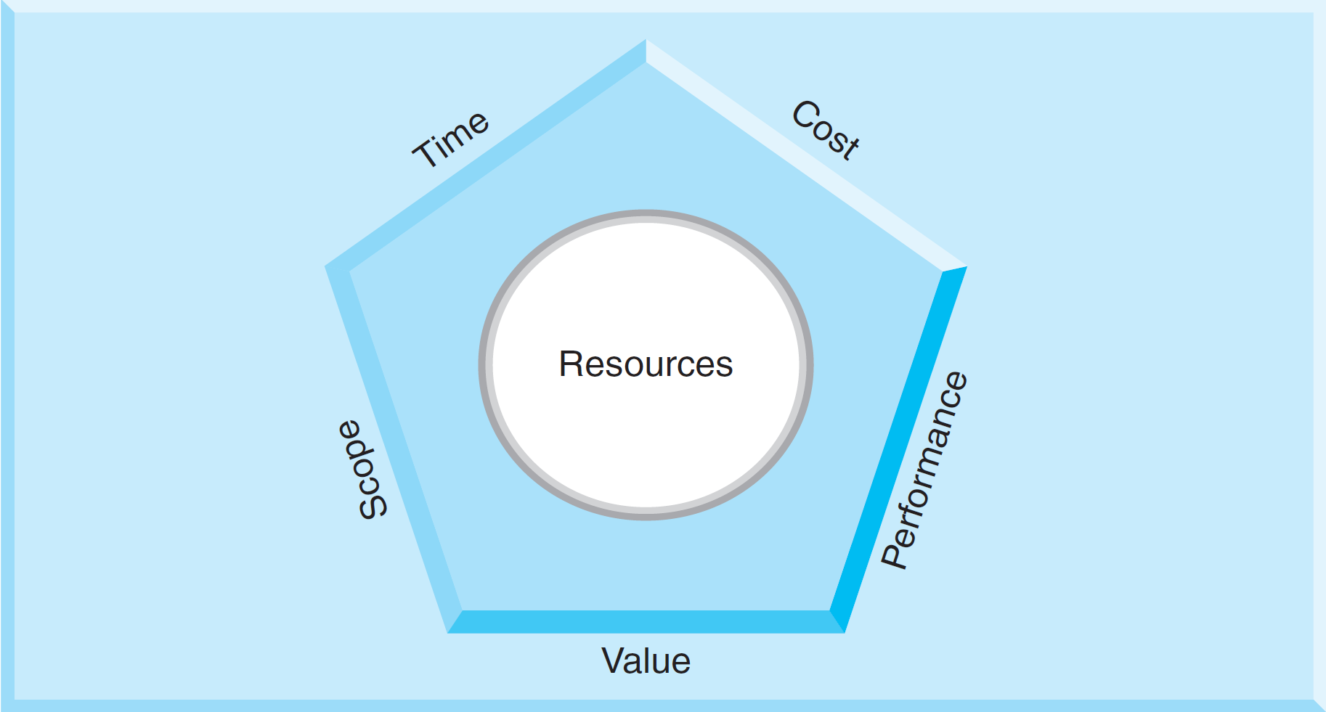
Factors and Constraints

Slide 23
Project Scope and Product Scope
The scope of a project is the work that needs to be accomplished to deliver the results of the project with specified features and functions.
Scope is based on the customer and organizational requirements of a project, and the scope constraint refers to what must be done to produce the project's end result.
The scope of a product is the general work that needs to be accomplished to deliver a product, a system, a structure, or a service with the specified features and functions.
The product scope consists of the features and functions that characterize a product, a service, a system, or a structure.

Slide 24
Other factors of success
Project schedule: The list of all activities of a project with intended start and end dates linked by dependencies and constrains of a project
Project cost: The sum of all costs to complete a project
Project resources: An available supply of assets, capabilities, processes, attributes, and knowledge in an organization
Project performance: The overall quality of a project in terms of its impacts and benefits
Project value: The overall worth of a project

Slide 25
Six Factors of Project Success
Impact of six factors on project success
Factors | Impacts
Scope | Increase in scope can lead to increased time, increased cost, better or worse performance, increase in resources, and increase or decrease in value
Time | Tight time constraint can lead to increased cost, reduced scope, reduced performance, increase in resources, and reduced value
Cost | Tight budget constraint can lead to increased time, reduced scope, reduced performance, increase or decrease in resources, and reduced value

Slide 26
Six Factors of Project Success
Impact of six factors on project success
Factors | Impacts
Resources | Unskilled, less, faulty, bad quality resources lead to increased time, reduced performance, reduced value, higher costs, and short of scope
Performance | Stringent performance measures can lead to increased time, increased scope, increased cost, increase or decrease in resources, and increase or decrease in value
Value | Expected value measures can lead to increased scope, increased time, increased cost, demand for better resources, and better or worse performance

Slide 27
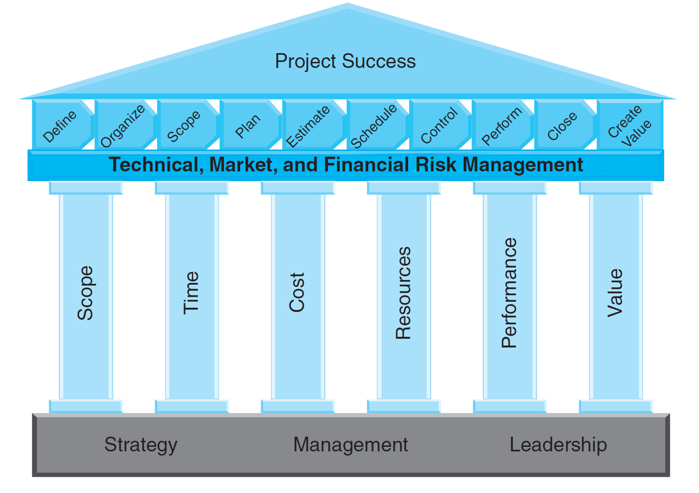
Project Management Components

Slide 28
Summary
A project is a unique activity that adds value, has beginning and end dates, and has constraints that include scope, cost, schedule, resource, performance, and value (customer satisfaction).
Using technological uncertainty and technological complexity as two dimensions, we can classify projects.
In general, there are six distinct phases of a project in a project life span
Organizations that work on various projects need to acquire good project management skills and techniques.

Slide 29
